Slide 1
Section 2.1: Controversial Elections
Math for Liberal Studies

Slide 2
How do we choose the winner of an election?
Harder than you might think
There are many examples in history where the results were disputed
We care about this because we want the outcome of the election to be “fair”

Slide 3
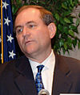
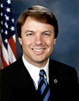
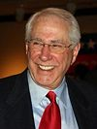
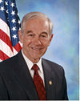
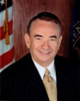
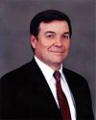
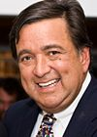
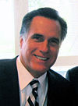
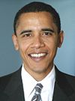
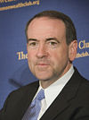
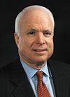
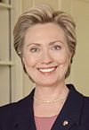
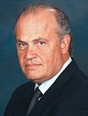
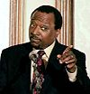
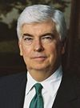
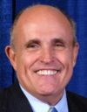
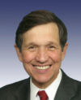
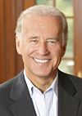
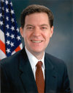
2008 Presidential Campaign

Slide 4
Primaries
One purpose of primary elections is to narrow such a wide field down to a single nominee for each party
A common criticism of the primary process is that some states are more important than others
Pennsylvania’s primary wasn’t until April 22nd, but the first was the Iowa caucus on January 3rd
Since the Democratic primary election was so close, many states with late primaries that ordinarily wouldn’t have been important were suddenly vital to each candidate’s success

Slide 5
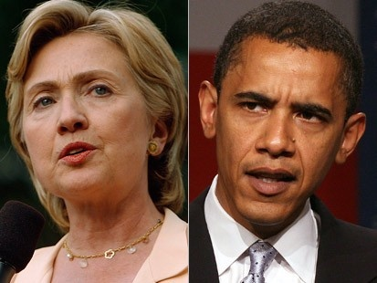
Controversy
Whenever an election is close, there is usually controversy
A recent example of this was the Democratic primary involving Barack Obama and Hillary Clinton
Some Clinton supporters didn’t initially support Obama after his nomination, even though they agreed on many policies

Slide 6
Historical Controversies
This is far from the first time there was a controversial election that got national attention
We will look at several examples from recent (and not so recent) years

Slide 7
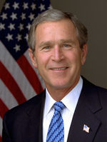
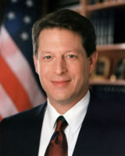
2000 Presidential Election
Al Gore vs. George W. Bush
There were two other candidates: Ralph Nader (Green Party) and Pat Buchanan (Reform Party)
The result of the popular vote was:
Gore 48.4%
Bush 47.9%
Nader 2.7%
Buchanan 0.4%

Slide 8
Controversy in 2000
Even though Al Gore won the popular vote, George W. Bush won the electoral college
The result of Florida was in dispute for several weeks, but eventually Florida’s electoral votes were given to Bush after the Supreme Court ordered a stop to recounts
The official margin of victory for Bush in Florida was 537 votes, out of 5.8 million votes cast

Slide 9
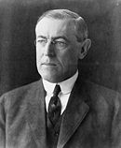
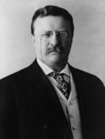
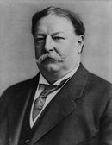
1912 Presidential Election
Woodrow Wilson
The election in 2000 wasn’t the first time there had been a third-party “spoiler” in a national election
In 1912, after Theodore Roosevelt failed to get the Republican party nomination, he ran as a third-party candidate
This split the Republican vote, and Woodrow Wilson, the Democrat, won the election with only 42% of the popular vote
Theodore
Roosevelt
William Howard Taft

Slide 10
“Spoiler” Candidates
The example from 1912 teaches us that two candidates can “split” a large portion of the voters, leading to an unanticipated outcome
For example, if Hillary Clinton had decided, after losing the Democratic nomination to Barack Obama, to run as a third-party candidate, this would almost certainly have guaranteed that McCain would have won the 2008 Presidential race

Slide 11
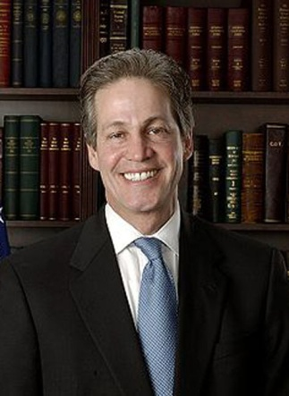
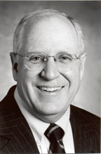
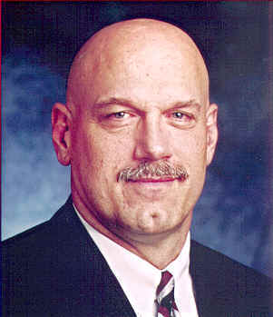
1998 Minnesota Gubernatorial Election
Norm Coleman
Three main candidates:
Norm Coleman (R)
Hubert Humphrey (D)
Jesse Ventura (Reform Party)
The results of the vote were:
Ventura (37%)
Coleman (34%)
Humphrey (28%)
Hubert Humphrey
Jesse Ventura

Slide 12
Why were these results controversial?
Few people expected the former professional wrestler to win the election
Most of the people who voted for Coleman or Humphrey probably had Ventura as their last choice
That means that Ventura was elected governor even though 63% of the voters would have ranked him last!

Slide 13
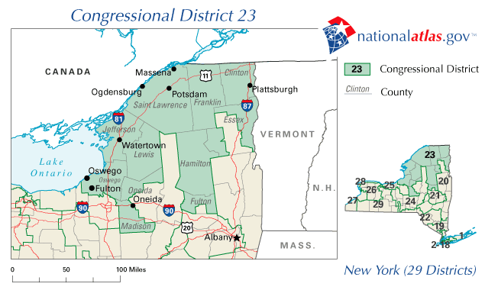
NY 23rd Congressional District, 2009
In New York’s 23rd Congressional District, there was a special election in 2009 after Congressman John McHugh was confirmed as Secretary of the Army

Slide 14
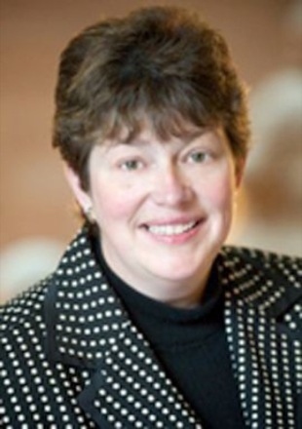
NY 23rd Congressional District, 2009
This district had been in Republican hands for over 100 years
However, many Republicans did not approve of the moderate Republican candidate, Diedre Scozzafava

Slide 15
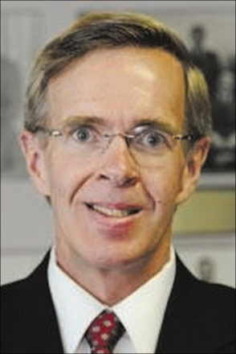
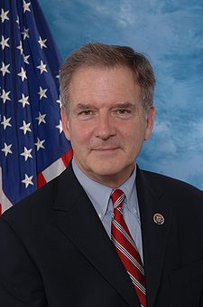
NY 23rd Congressional District, 2009
Many prominent conservatives, including Newt Gingrich and Sarah Palin, endorsed the Conservative Party candidate, Doug Hoffman
This split the Republican vote, even though at the last minute Scozzafava dropped out of the race and endorsed the Democratic candidate, Bill Owens

Slide 16
NY 23rd Congressional District, 2009
The result of the election was:
Owens (D): 73,137 (48.3%)
Hoffman (C): 69,553 (46.0%)
Scozzafava (R): 8,582 (5.7%)
Should Owens have won the election? Why or why not?

Slide 17
How do we choose the winner of an election?
There are many different systems, as we will learn
The most common system used in US elections is the plurality system: the candidate who gets more votes than any other candidate is said to receive a “plurality”
A candidate receives a “majority” if they earn more than half of the total number of votes

Slide 18
How do we choose the winner of an election?
Al Gore won a plurality of the popular vote in 2000
Woodrow Wilson won a plurality of the popular vote in 1912
Jesse Ventura won a plurality in 1998
Bill Owens won a plurality in 2009
None of these candidates won a majority

Slide 19
Example
Suppose we have an election for where to eat lunch:
Quizno’s
Chick-fil-A
Subway
Everyone votes for their favorite choice

Slide 20
Interpreting the Results
Suppose the results look like this:
Quizno’s: 13 votes
Chick-fil-A: 16 votes
Subway: 8 votes
According to the plurality method, Chick-fil-A wins with 16 votes, which was more than any other candidate

Slide 21
Majority versus Plurality
Chick-fil-A won a plurality, but did it have a majority?
There were 13+16+8 = 37 votes total
A majority would be more than 37÷2 = 18.5 votes
So Chick-fil-A didn’t get a majority

Slide 22
What’s wrong with plurality?
When a candidate wins an election without winning a majority of the votes, this often creates controversy
People who vote for 3rd party candidates are often said to be “throwing away” their votes since these minor-party candidates are unlikely to win

Slide 23
What’s wrong with plurality?
Recall the result of the election in New York’s 23rd district:
Owens (D): 73,137 (48.3%)
Hoffman (C): 69,553 (46.0%)
Scozzafava (R): 8,582 (5.7%)
Scozzafava had dropped out of the race; since she was the Republican candidate, would it be fair to assume that those 8,582 voters preferred Hoffman over Owens?

Slide 24
A Look Ahead
In this unit, we will study some other things that can go wrong in the course of an election
We will also explore alternate methods for determining the winner of an election
We will learn how representatives are assigned to states of various sizes
Finally, we will study the relative power that states with varying numbers of representatives have

